Slide 1
READ MY LIPS
Abhinav Reddy
Ankita Agarwal
Arjun Surendran
Nazim Shaikh
Suchismita Sahu

Slide 2
INTRODUCTION
As highlighted by the McGurk effect where one phoneme’s audio dubbed on top of a video of someone speaking a different phoneme results in a third phoneme being perceived, we understand that lipreading plays a crucial role in speech understanding.
Thus, lipreading is a notoriously difficult task for humans, specially in the absence of context.
An important goal, therefore, is to automate lipreading.

Slide 3
WHY THIS IS NEEDED?
Can be used to transcribe video to text where audio is unreliable due to noisy environments.
Can be used to supplement audio communication for patients with ALS, Hearing Difficulty etc.
Can aid human machine interaction in noisy environments.
Can be used to improve speaker diarization.

Slide 4
DESCRIPTION
The goal of this project is to recognize phonemes from the sentences spoken by a person using a multimodal system with video and audio data.
Phase1: Identification of phoneme sequences from audio data.
Phase 2 : Identification of Phoneme sequence from Video.
End Goal: To detect phoneme sequences from image sequences.

Slide 5
DATASET
We used TCD-TIMIT dataset which has 13826 video clips in MP4 format with 6913 phonetically rich sentences spoken by 62 Irish Speakers, 59 Volunteers and 3 lipspeakers, labeled phoneme-wise.
The video data is recorded at 1920x1080 resolution at 30 frames per second with uniform lighting. It is centered at the speakers face.

Slide 6
DATASET
The audio data is a series of wav files sampled at 48 kHz sampling rate with the corresponding phoneme files.
Each phoneme file has the list of phonemes in audio recording with their time alignments. The labels are a part of the set of 39 phonemes.

Slide 7
DATASET
We chose 30 Volunteers and 3 Lipspeakers from the entire dataset for training and model evaluation.
The Lipspeakers dataset we used contains 75GB of video recordings.

Slide 8
AUDIO PREPROCESSING
The audio data was resampled at 16 kHz to match phoneme alignments.
The 13 dimensional MFCCs are extracted from the audio data with a window frame of 25ms and 10ms overlap using Librosa.
These MFCC features are stacked with overlapping to encode the temporal information such that each frame has total 9 features with the central frame representing the true label, i.e rows are stacked 1-9, 2-10 and so on.

Slide 9
AUDIO NETWORK ARCHITECTURE
NETWORK:
2 layer LSTM with 256 units per layer one acting as encoder and the other acting as decoder which works along with the attention network. The output of this is passed on to a MLP.
MLP has 2 layers of Dense one with 256 neurons with tanh activation and next with 39 neurons with softmax activation to predict the probability of the phoneme sequence.
Total trainable Network parameters : 943,143
Loss Metric : Categorical Cross-entropy
Optimizer : Adam

Slide 10
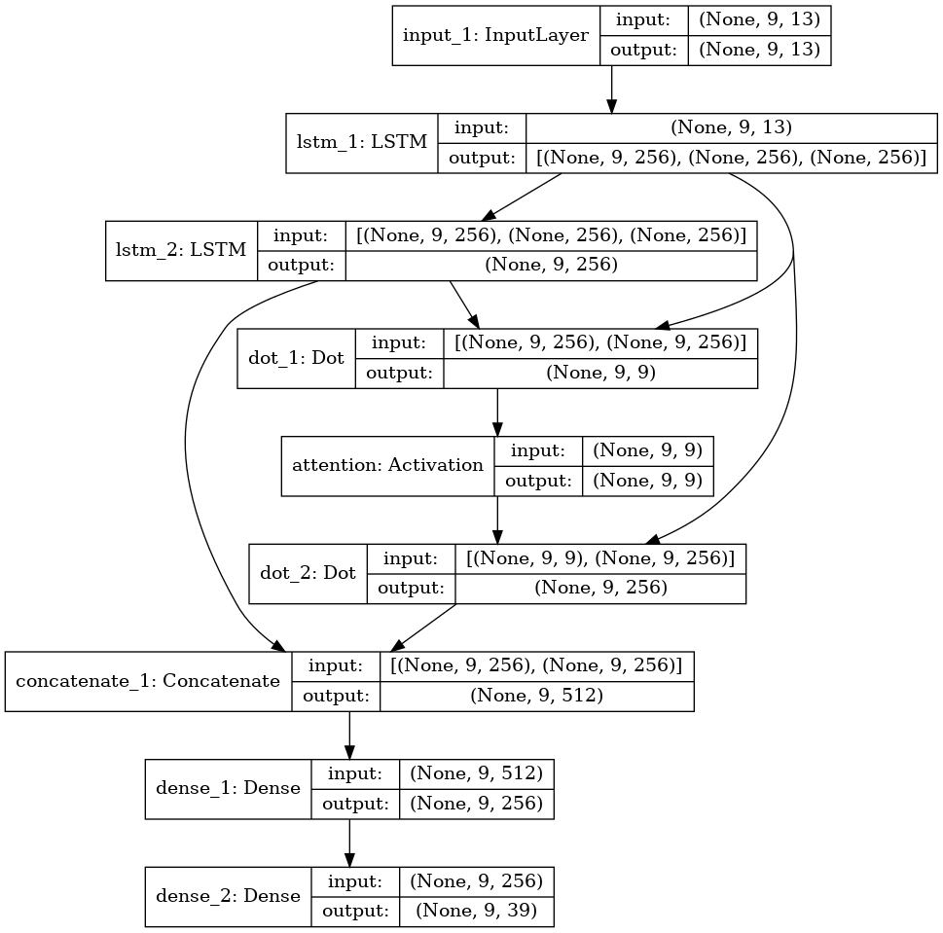

Slide 11
VIDEO PREPROCESSING
Frames were extracted from video using ffmpeg at 30fps.
For each image frame, the mouth region was extracted using Dlib, resized to 120 x 120 pixels and converted to standard grayscale format.
Each frame was then labelled with the corresponding phoneme according to the MLF Label files.
Images were then read in variable size batches, such that each batch contains the sequence of images corresponding to a single video file.

Slide 12
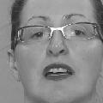
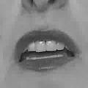

Slide 13
VIDEO NETWORK ARCHITECTURE
CNN Network:
Five CONV layers with ReLu activations
Four POOL layers performing max-pooling
Batch Normalization layer after each POOL layer. Output is flattened and passed to the next layer
We make use of LSTM layer to add temporal information to CNN features.
At the end, FC classification layer processes output at each timestep to generate phoneme predictions for each frame of the sequence.
Total Trainable Parameters: 19,173,351
Loss Metric : Categorical-cross-entropy
Optimizer : Adam

Slide 14
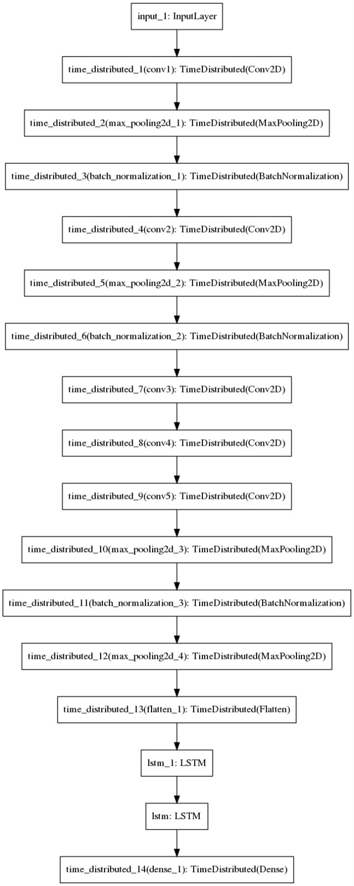
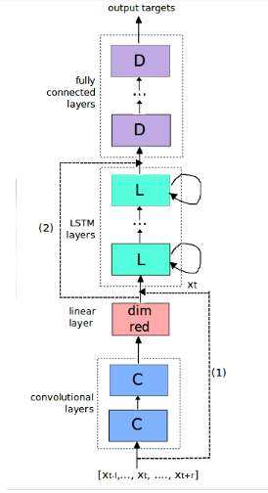

Slide 15
AUDIO-VIDEO COMBINED ARCHITECTURE
Best performing models for both the audio and video subnetworks were saved and loaded.
A single hidden layer fully connected network with 256 neurons is used for phoneme prediction from the predictions of audio and video networks.
The purpose of this network is to make a weighted prediction from outputs of both networks.
In other words, it learns which of the two networks predicts certain phonemes better, and assigns weights accordingly.

Slide 16
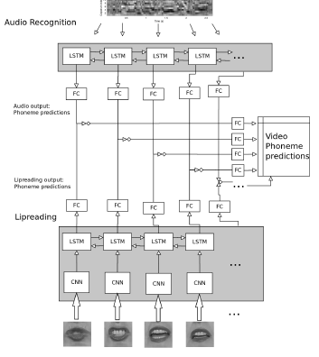

Slide 17
TRAINING
The labels for both audio and video were one hot encoded.
We used 50 epochs with early stopping along with best model checkpoint.
The time required for training each epoch was approximately 10 minutes.
Evaluated the model using Top-1, Top-3 and Top-5 accuracy metrics.

Slide 18
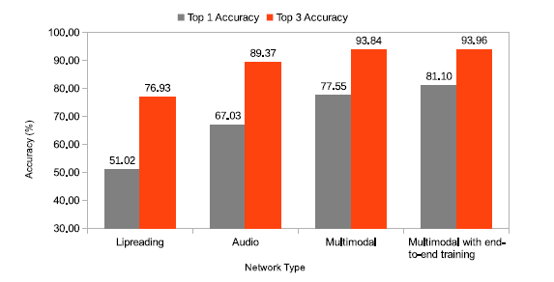
REFERENCE RESULTS

Slide 19
RESULTS (TOP-1 ACCURACY(~%))
 |  | AUDIO SUBNETWORK | VIDEO SUBNETWORK | AUDIO-VIDEO SUBNETWORK
TRAIN SET | TEST SET
LIPSPEAKER | LIPSPEAKER | 70.51 | 37.5 | 41.12
LIPSPEAKER | VOLUNTEER | 53.2 | 25.67 | 31.95

Slide 20
MAJOR CHALLENGES
Building a network that performs well on our video data was a big challenge. We tried implementing many architectures for the CNN module in CNN-LSTM combination network. The model that best balances the weights and computational complexity was chosen.
Synchronizing the audio-video data to get the combined prediction was challenging. Attention Network was implemented but it did not give best results.
For improving performance of video subnetwork, we tried data augmentation on images but didn’t see improvement in results.

Slide 21
FURTHER IMPROVEMENTS
Using the straight cam and the 30 degree video data to train the video network.
Training the networks with added noise.
Using dataset with more and a diverse set of speakers e.g. of different nationalities.
Extending the phoneme level prediction to word level and sentence level prediction.

Slide 22
INDIVIDUAL CONTRIBUTIONS
ABHINAV REDDY: Video Preprocessing ,Data generator for network input, testing video model on standard CNN networks .
ANKITA AGARWAL: Audio Preprocessing , data restructuring , building audio subnetwork.
ARJUN SURENDRAN: Audio Preprocessing , Building and training audio subnetwork with attention , Combining audio-video subnetworks.
NAZIM SHAIKH: Building and training video subnetwork, Combining audio-video subnetworks.
SUCHISMITA SAHU: Literature review, Building video subnetwork, tuning & testing on various state of the art networks.

Slide 23
REFERENCES
“Lip Reading sentences in the wild” https://www.robots.ox.ac.uk/~vgg/publications/2017/Chung17/chung17.pdf
“Read My Lips” cs230.stanford.edu/files_winter_2018/projects/6940477.pdf
“Lip reading using CNN and LSTM” cs231n.stanford.edu/reports/2016/pdfs/217_Report.pdf
“Multimodal speech recognition using lipreading (with CNNs) and audio (using LSTMs)” https://github.com/matthijsvk/multimodalSR
Harte, N.; Gillen, E., "TCD-TIMIT: An Audio-Visual Corpus of Continuous Speech," Multimedia, IEEE Transactions on , vol.17, no.5, pp.603,615, May 2015 doi: 10.1109/TMM.2015.2407694

Slide 24
Thank You !

